Slide 1
Digital Portfolio
STUDENT NAME: Ashik Irfaan A
REGISTER NO: 2426K0053
NMID: FD590FF5E91CDCAAD14403C49CB41E2C
DEPARTMENT: Computer Technology
COLLEGE: Sri Krishna Adithya College of Arts and Science / Bharathiyar University

Slide 2
PROJECT TITLE
Interactive Student Portfolio Website using Frontend Web Development

Slide 3

AGENDA
Problem Statement
Project Overview
End Users
Tools and Technologies
Portfolio design and Layout
Features and Functionality
Results and Screenshots
Conclusion
Github Link

Slide 4

PROBLEM STATEMENT
Many students lack a professional online presence.
Traditional resumes are static and do not showcase projects, skills, and achievements interactively.
Need for a personal portfolio website where:
- Students can highlight their skills & projects.
- Recruiters/teachers can easily access student information.
- Acts as a digital resume

Slide 5
PROJECT OVERVIEW
A personal portfolio website created using HTML, CSS, and JavaScript.
Showcases my:
- Personal introduction (About Me)
- Skills
- Projects (Java, Web Development, etc.)
- Contact Information
Responsive and user-friendly design.
Developed as part of Naan Mudhalvan Project.

Slide 6

WHO ARE THE END USERS?
Students → to present their profile and achievements.
Recruiters/Employers → quick overview of skills & projects.
College Faculty → to evaluate project work.
Peers & Community → to collaborate and connect.

Slide 7
TOOLS AND TECHNIQUES
Languages Used:
- HTML5 (structure)
- CSS3 (styling, layout)
- JavaScript (interactivity)
IDE/Editor: Visual Studio Code
Extensions Used: Live Server, Prettier, HTML-CSS Support
Version Control: GitHub (for hosting code)
Optional Libraries: Font Awesome (icons), Google Fonts

Slide 8
POTFOLIO DESIGN AND LAYOUT
Sections in Website:
- Home (Welcome + Profile Photo + Social Links)
- About Me (Introduction, Career Goals, Naan Mudhalvan context)
- Skills (Technical skills like HTML, CSS, JS, Java, Python, SQL)
- Projects (Java & Web Projects)
- Contact Form (for direct communication)
8

Slide 9
Design Features:
- Modern UI with gradients & hover effects
- Responsive layout (works on mobile & desktop)
- Simple navigation bar (sticky)

Slide 10
FEATURES AND FUNCTIONALITY
Responsive Home Page with Photo + Social Media Links.
About Section with Naan Mudhalvan Course details.
Skills Section with hover highlights.
Projects Section:
- Portfolio Website
- Student Result System (Web App)
- Tic Tac Toe Game (Java)
- Note-Making App (Java Swing)
Contact Form → allows visitors to send a message.

Slide 11
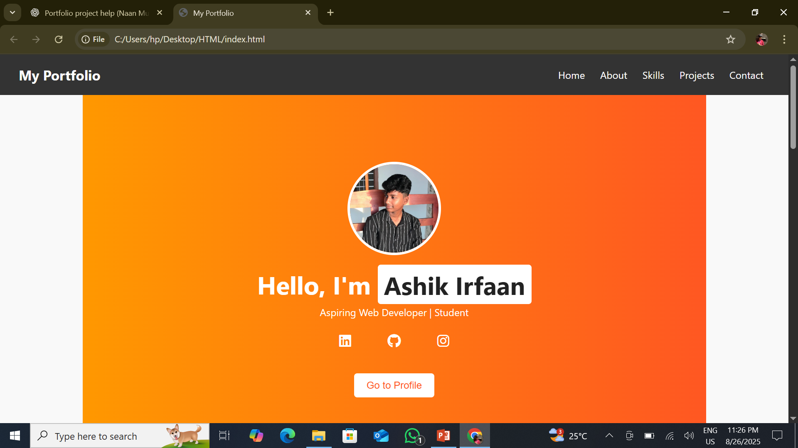
RESULTS AND SCREENSHOTS
Homepage with profile picture
11

Slide 12
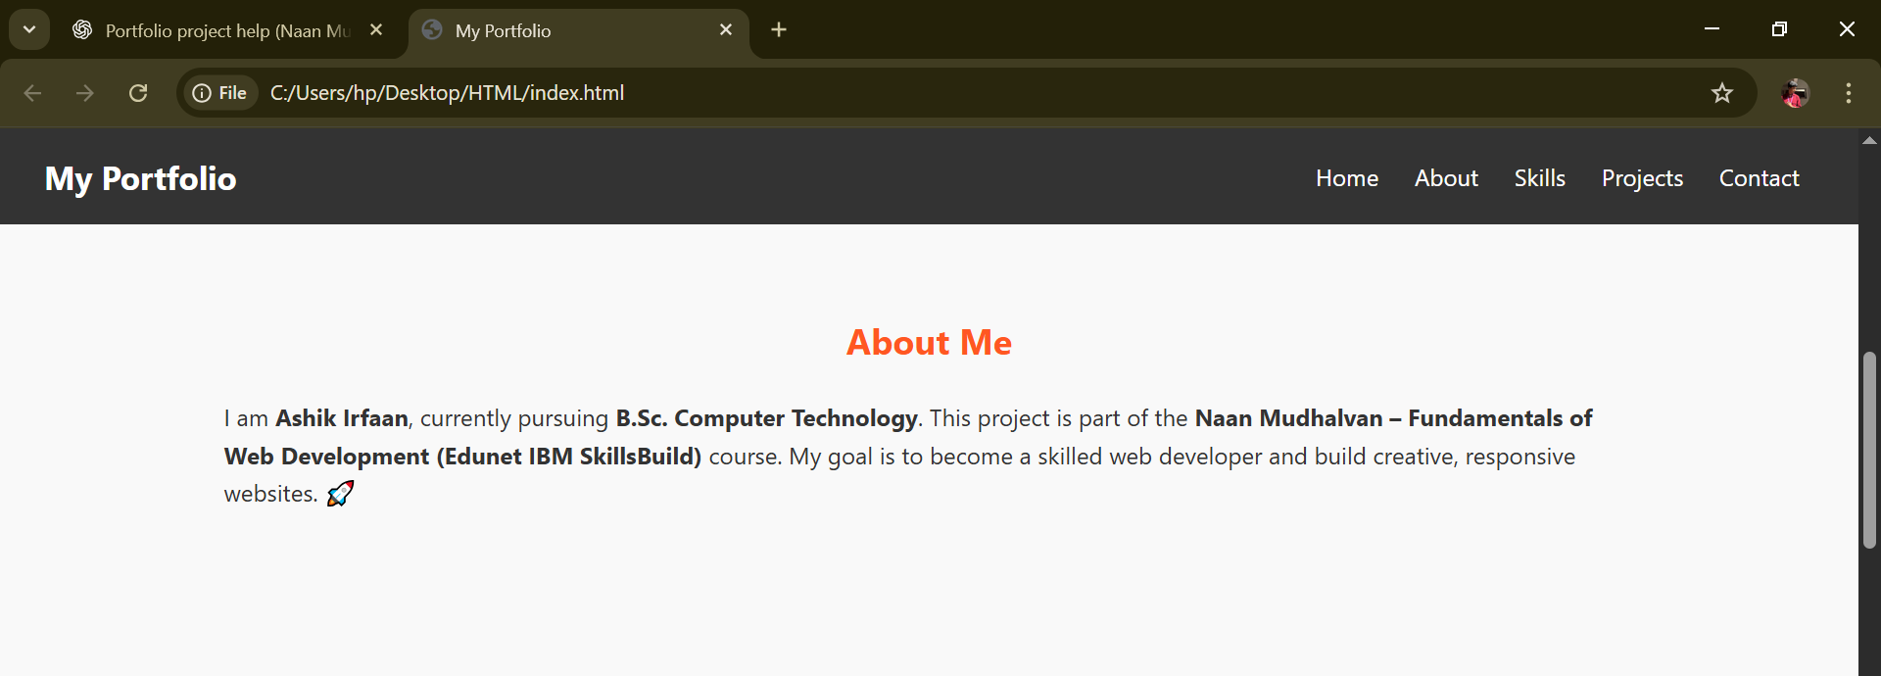
About Section

Slide 13
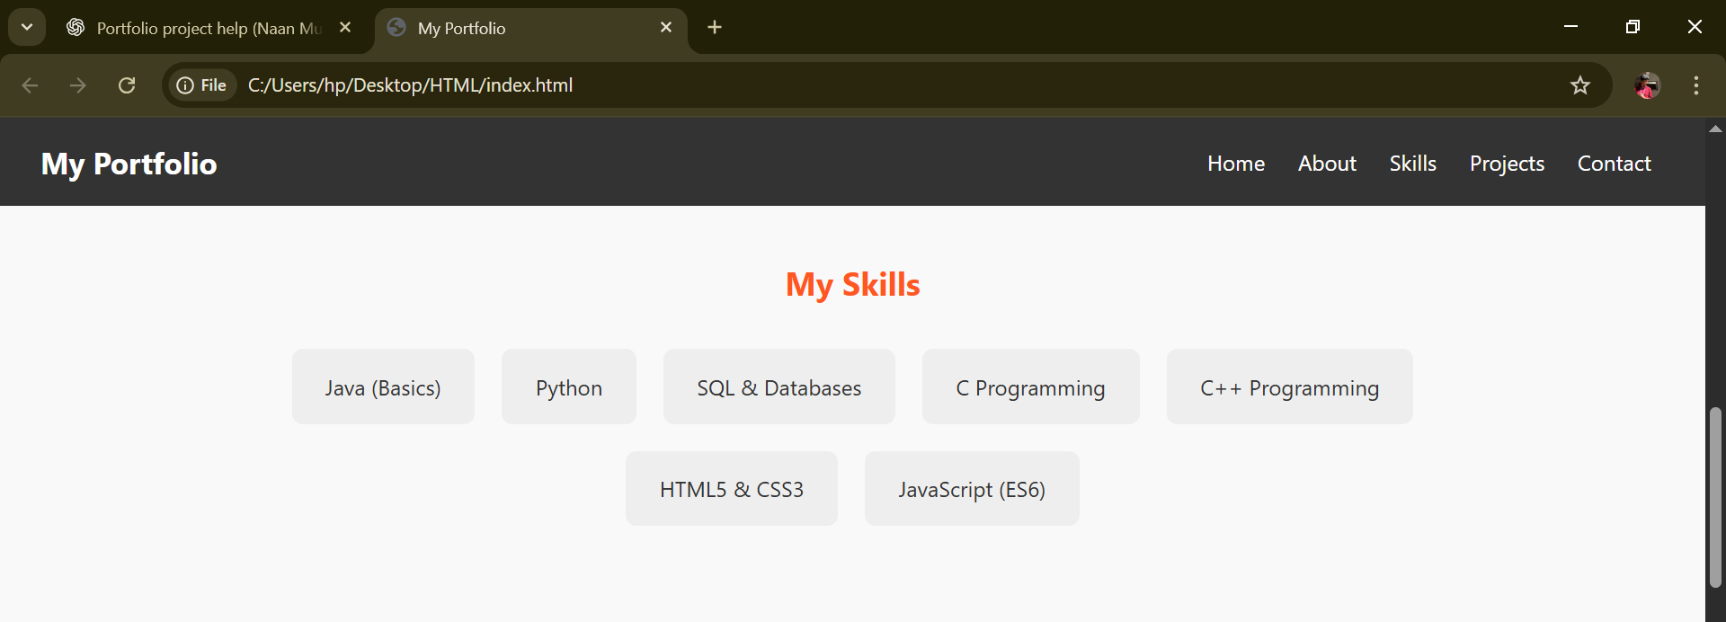
Skills Section

Slide 14
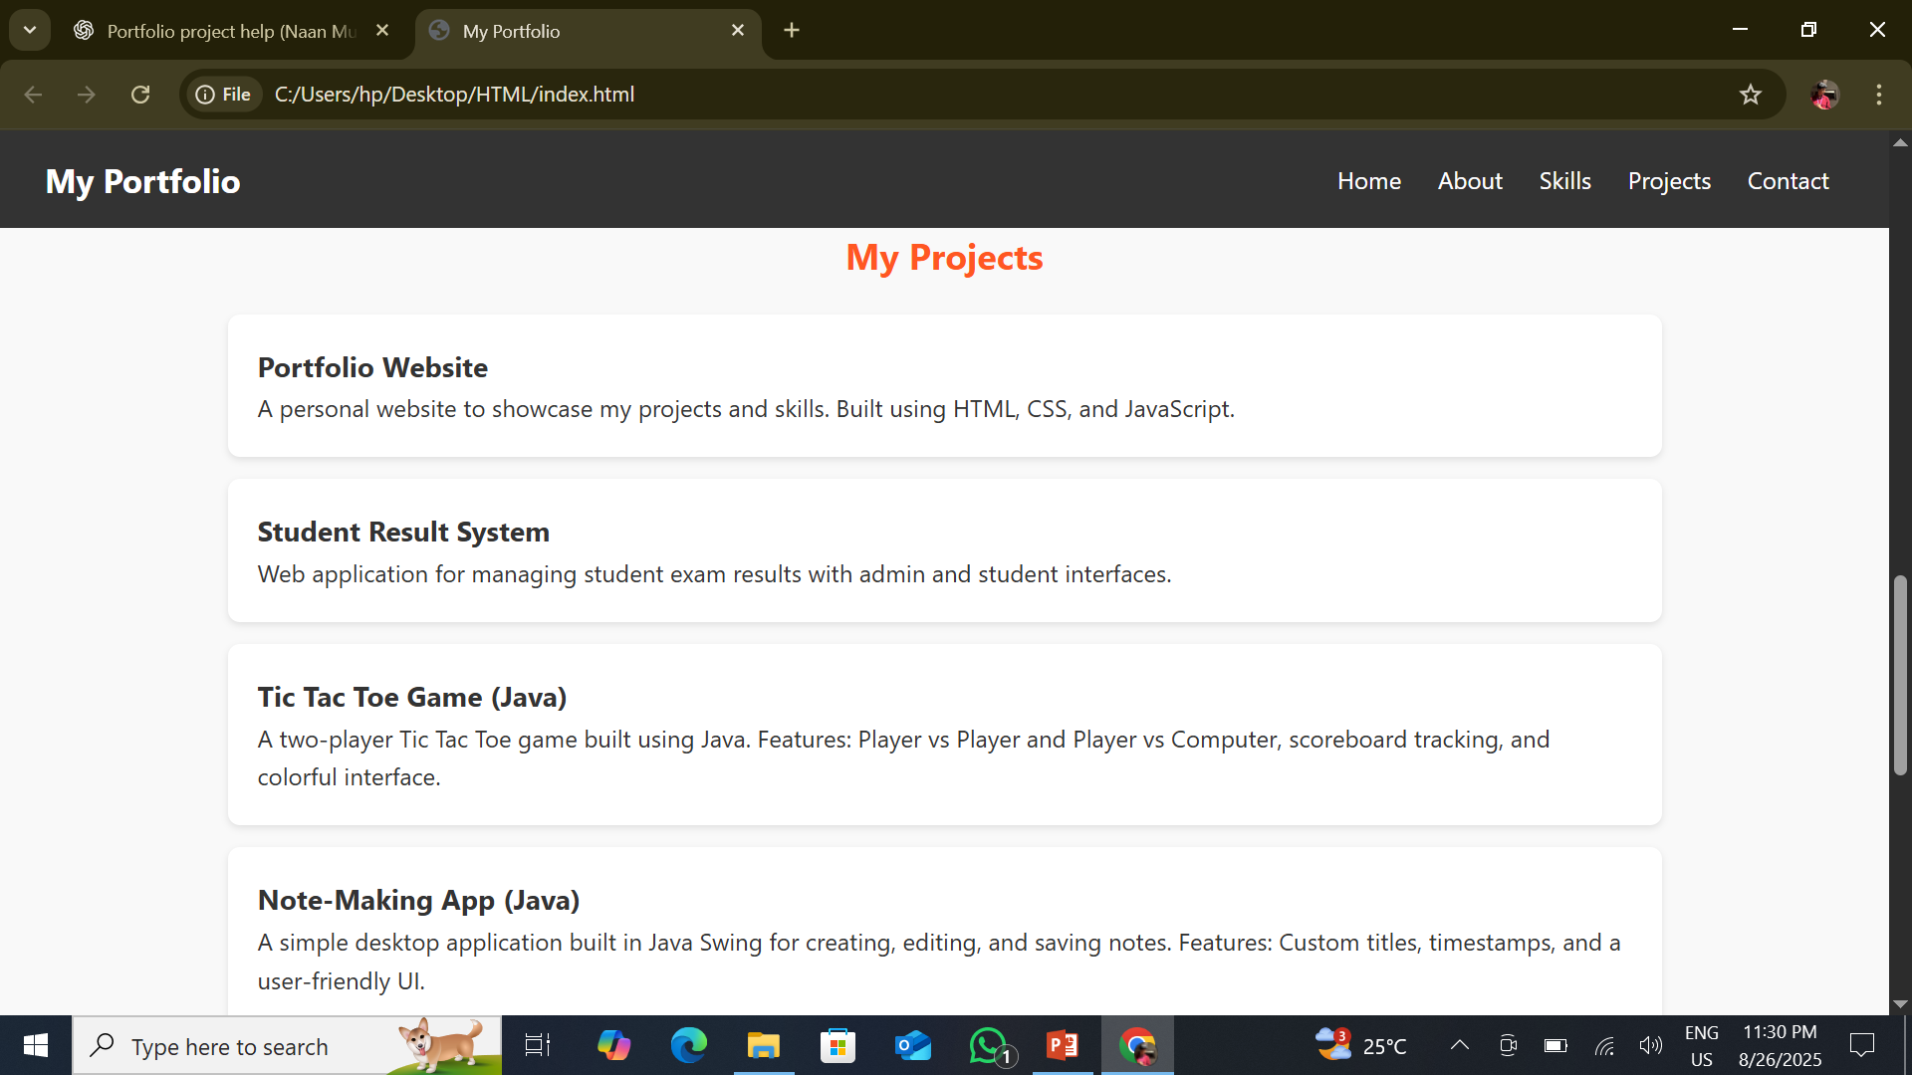
Projects Section

Slide 15
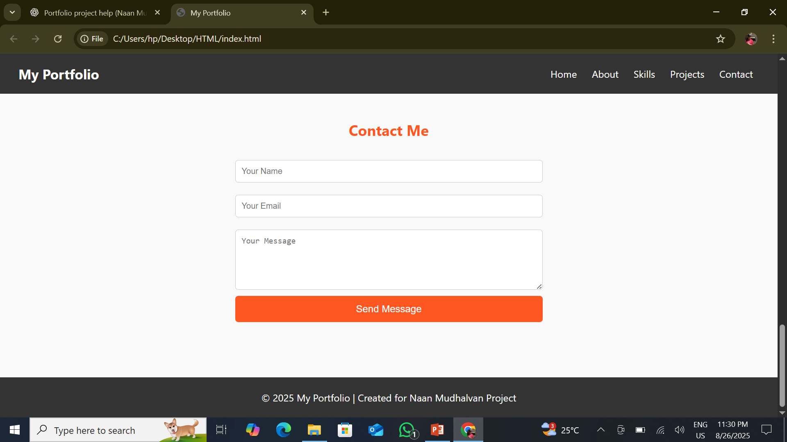
Contact Form

Slide 16
CONCLUSION
Successfully developed a Portfolio Website for self-branding.
Learned fundamentals of web development (HTML, CSS, JavaScript).
Integrated academic & personal projects for better career opportunities.
Acts as a digital resume + project showcase.
Future Scope:
- Host website online using GitHub Pages
- Add more advanced features (animations, dark mode, blogs)
16

Slide 17
Github Link
https://github.com/Ashik-Irfaan/STUDENT-DIGITAL-PORTFOLIO-ASHIK.git

